Slide 1
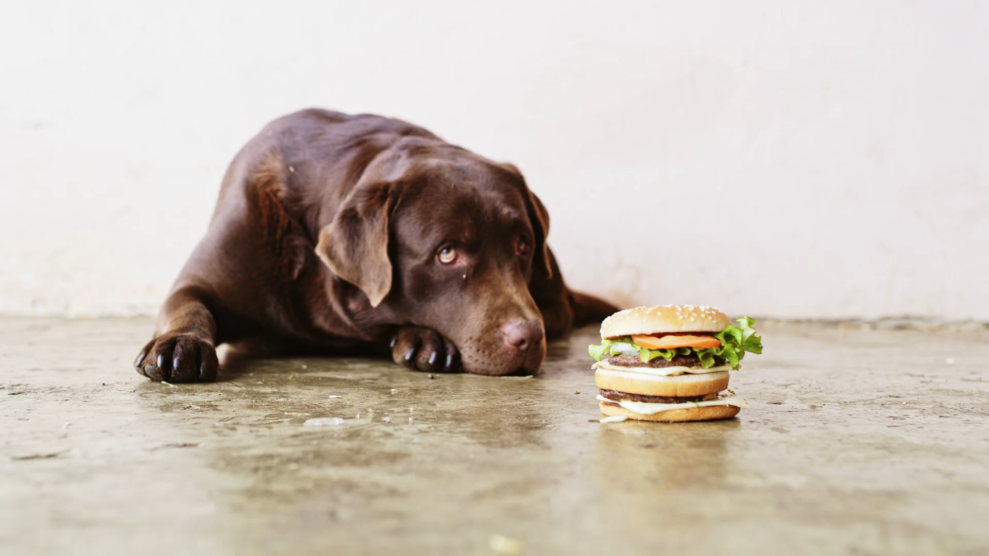
Boredom based time-slicing for learning control policies

Slide 2
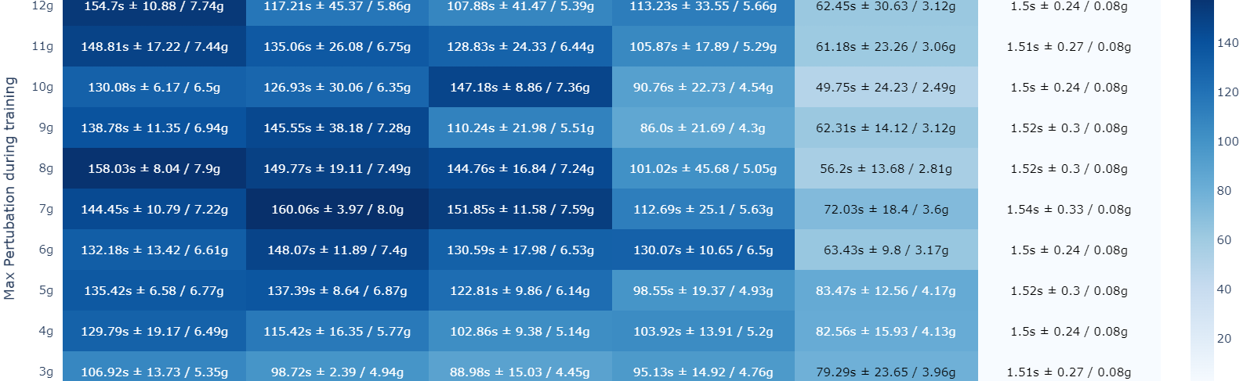
Why is quicker reaction speed not better?
It should be at least as good as the slower reaction speed if not better.
More total states while the network size and the replay memory size is the same
More steps to reward requiring more exploration initially also slowing training
Percentage of useful state action transitions to in the replay memory is reduced initially

Slide 3

Boredom based training
Start with a slow response time
Train until the TD-error is below a certain threshold
Reduce the response time
Repeat 1
s₁
s₂
a₀ , reward = 1
S_{1.5}
a₀ , reward = 0.5
a₁ , reward = 0.5
S_{1.25}
a₀ , reward = 0.25
a₁ , reward = 0.25
a₂ , reward = 0.25
a₃ , reward = 0.25
Possible advantages:
Faster learning / reduced need for exploration
Improve performance for fast response rates
Can learn the states with high TD error after transition and thus allow for adaptive time slicing
It should add precision to the Q values

Slide 4
First Steps this week
Implement it on inverted-pendulum and compare to our existing results.

